Slide 1
Introduction to weather radar
Jordi Figueras i Ventura Pyrad course

Slide 2
Contents
Introduction
Principles of weather radar
The weather radar equation
Polarimetry
Doppler measurements
Sources of uncertainty

Slide 3
1. Introduction

Slide 4
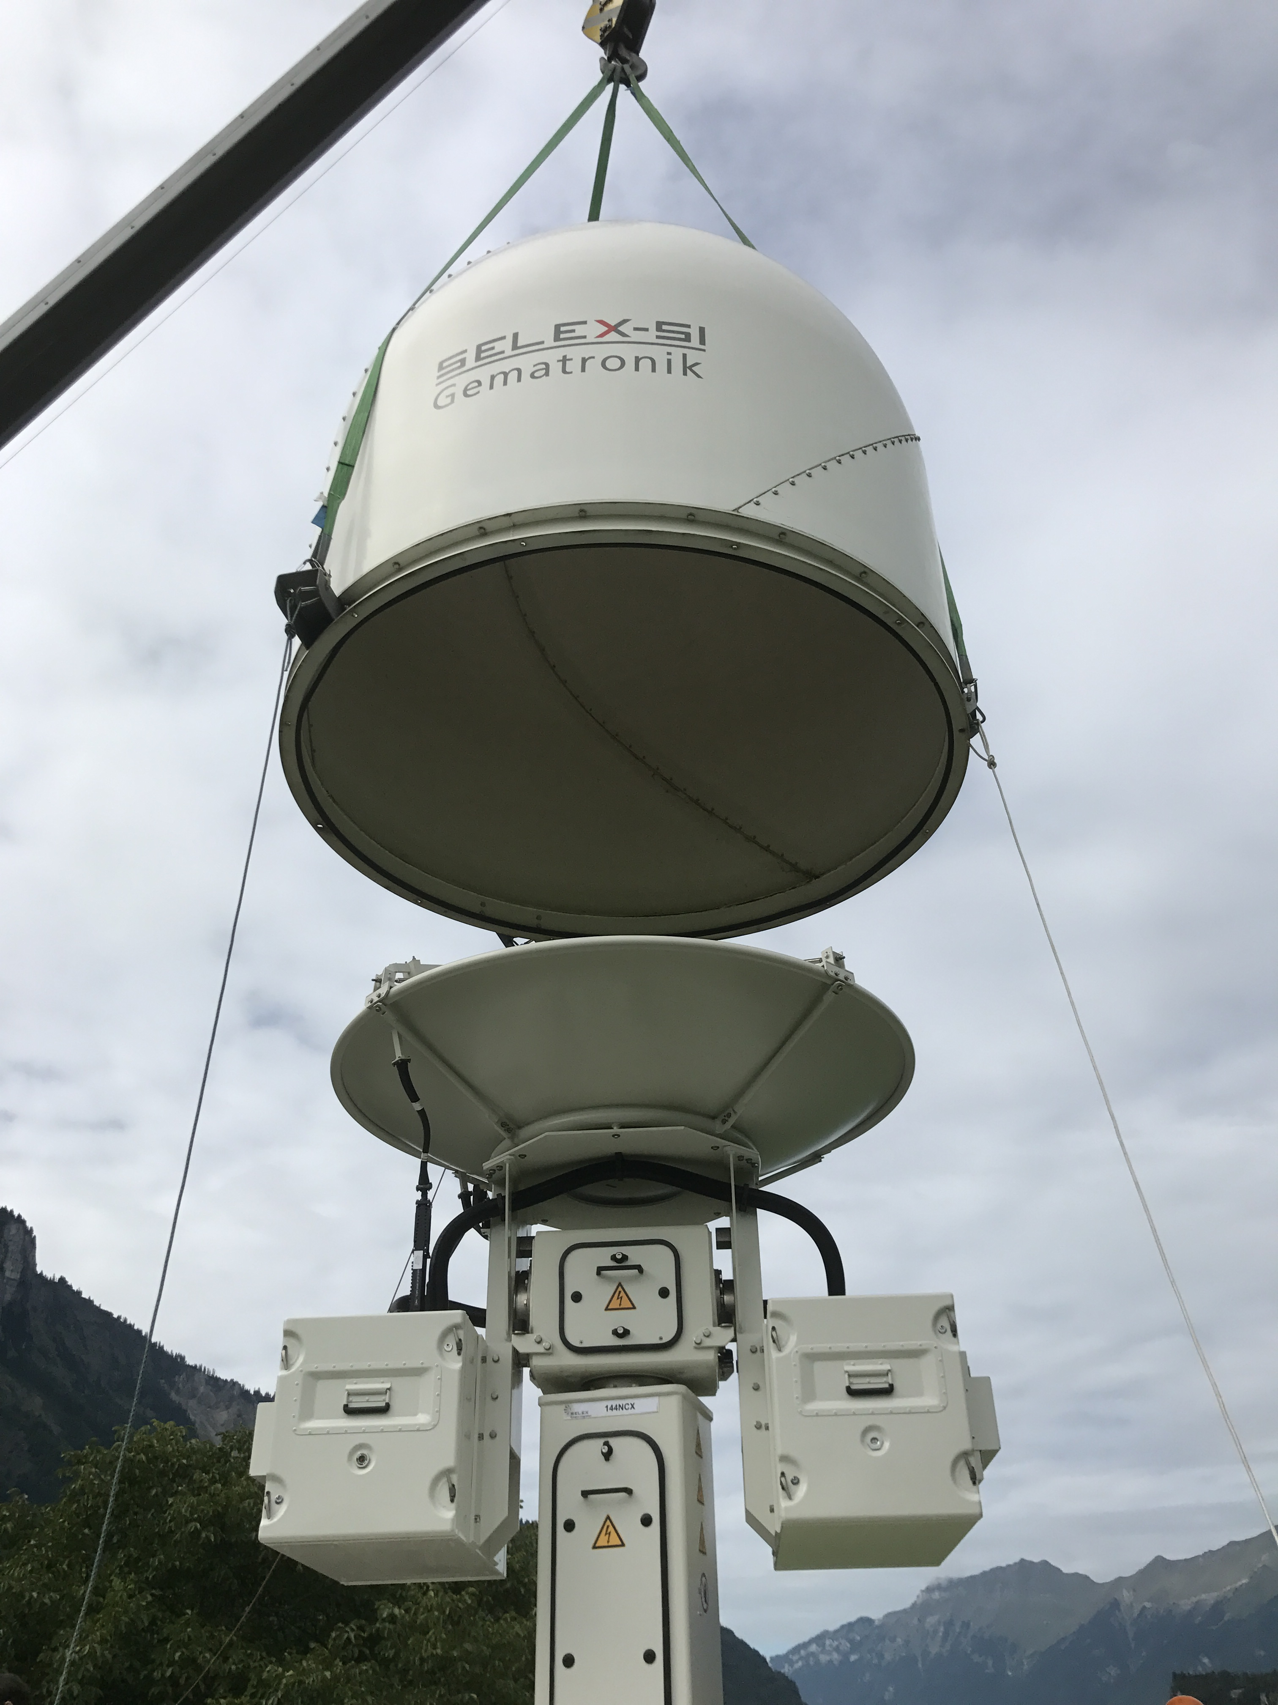
Definition
RADAR = RAdio Detection And Ranging
Cambridge Dictionary : a device or system for finding the position or speed of objects, such as aircraft, that cannot be seen, by measuring the direction and timing of short radio waves that are sent out and reflect back from the objects

Slide 5
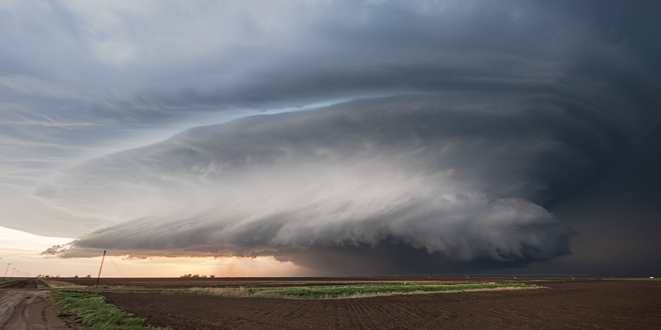
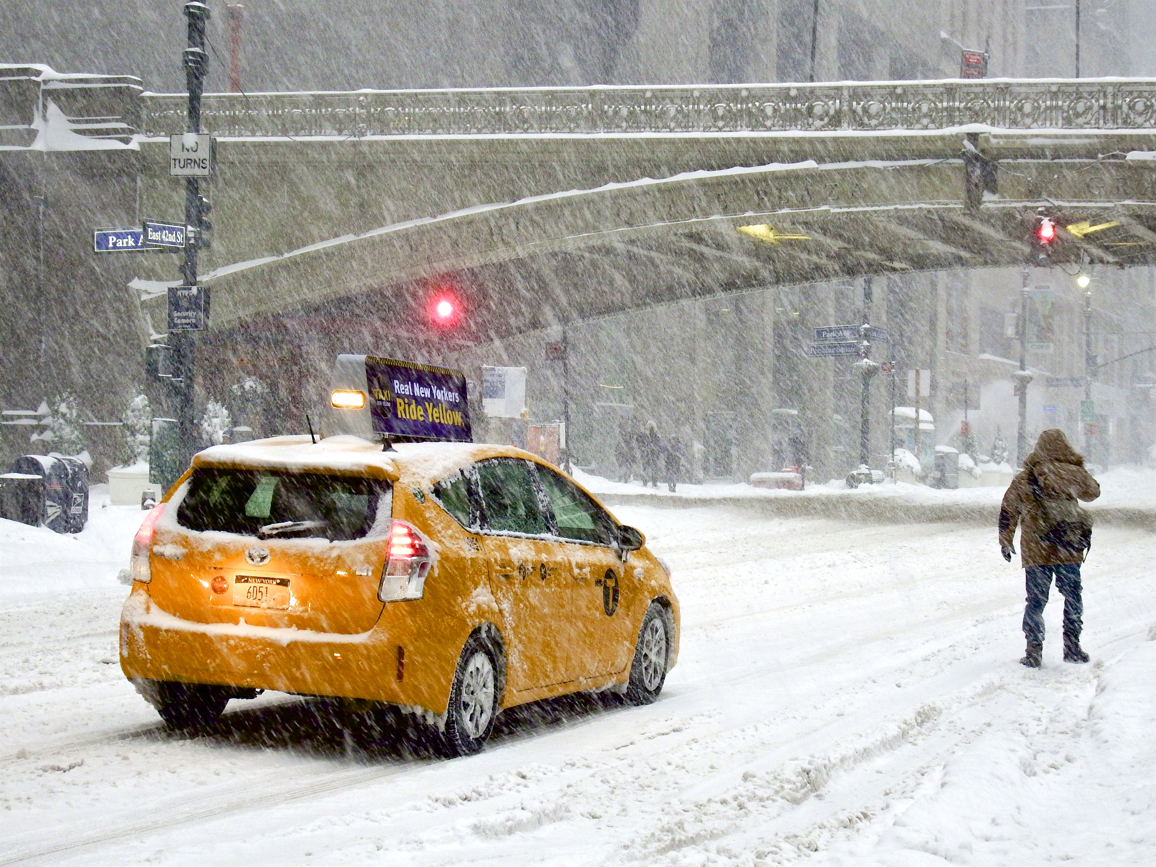
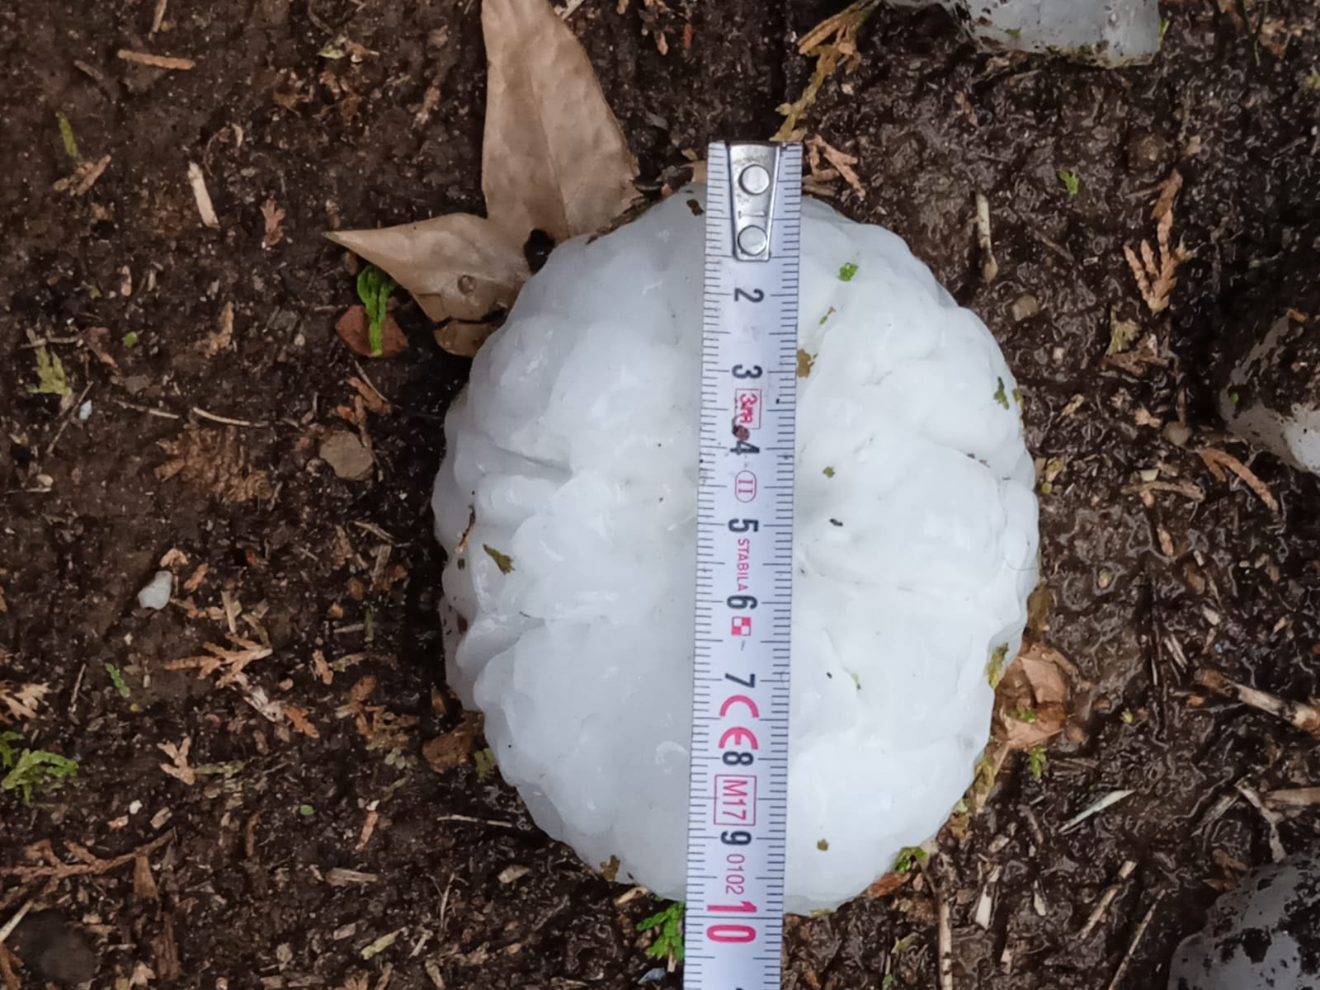
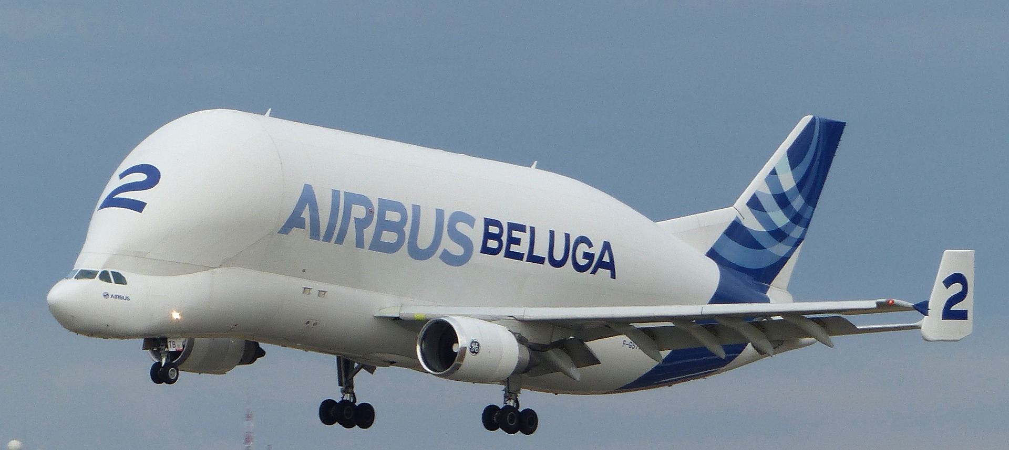
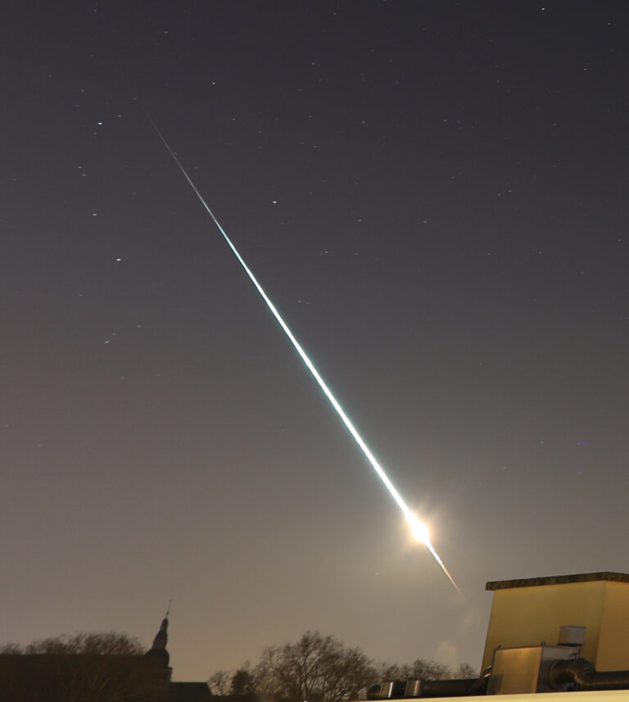
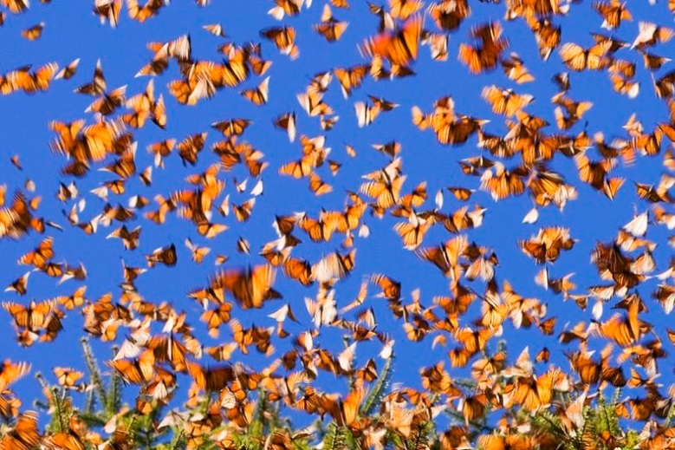
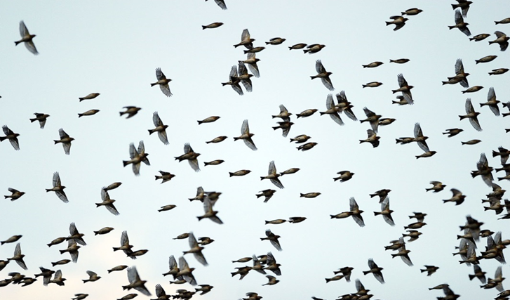
Purpose of a weather radar
The main purpose of a weather radar is to locate precipitation, calculate its motion and intensity and estimate its type
But other objects are also detected
©

Slide 6
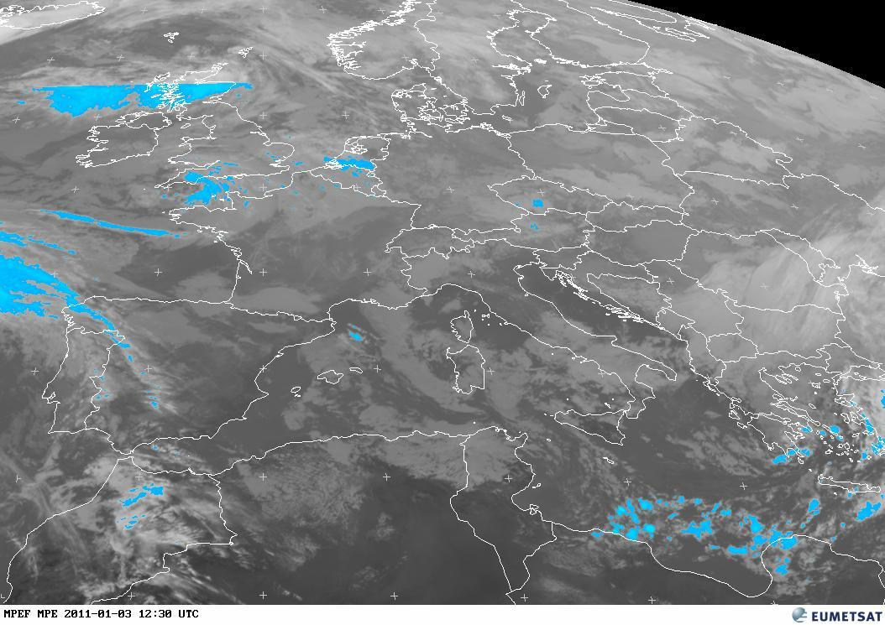
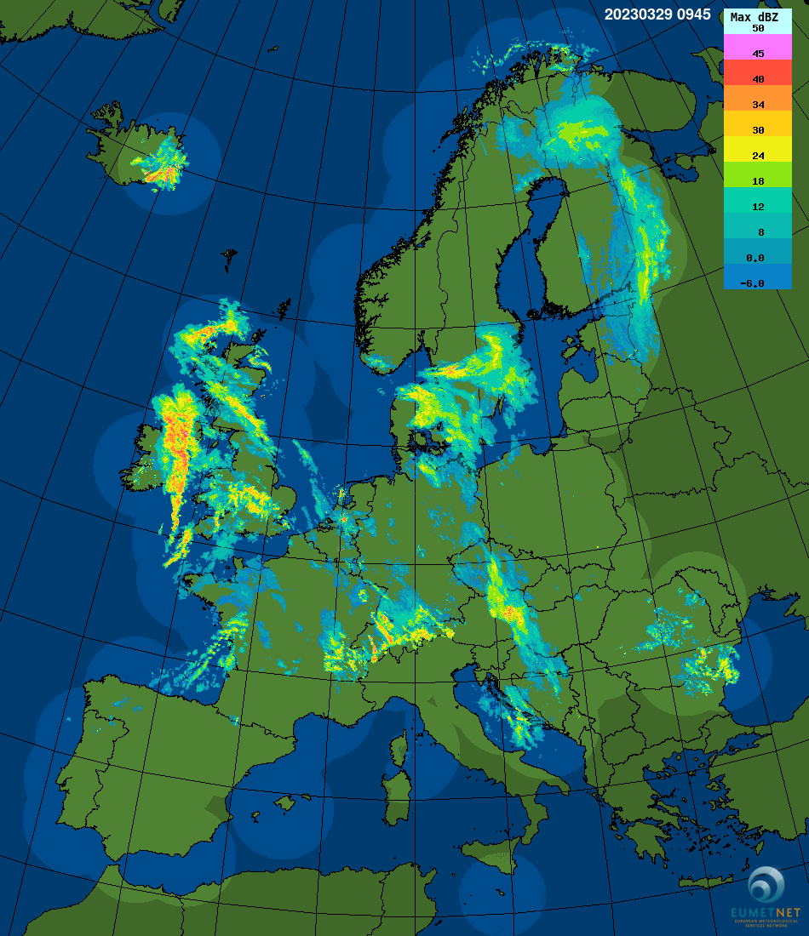
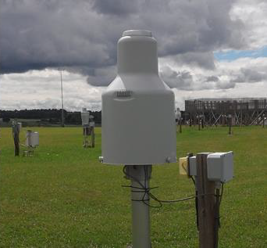
Instruments for precipitation detection
MSG : Multi-Sensor Precipitation Estimate (MPE)
Continental scale
15 min, 5 km
Indirect measurement
Better at low latitudes and for convective precipitation
Radar networks:
Range up to 400 km
~5 min, ~1 km
Indirect measurement
e.g 33 radars in France
Rain gauges networks :
0.1m scale
~10 min, 1h, 24h
Direct measurement
e.g. 551 real time RG in France

Slide 7
Why weather radar ?
Weather radar only instrument that provides :
Real time measurements
3D images of precipitation
High temporal and spatial resolution
For a wide range of precipitation intensity (from drizzle to hail)
At a long range (up to 400 km)
BUT
It is an indirect measurement and a lot of effort is required to go from measured voltage to mm/h

Slide 8
2. Principles of weather radar

Slide 9
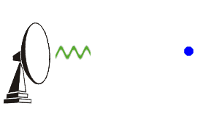
How it works (pulsed radar)
Emission to the atmosphere at regular intervals (PRT) of a pulse of energy of short duration (τ) and high power Pt and frequency (f, λ). The pulse is emitted by a directive antenna observing at a certain elevation (α) and azimuth (β) angles through a beam of angular size θ.
The scatterers at a particular range (r) absorb part of the energy and radiate in all directions. A small fraction of power (Pr) is sent back to the radar.
r
σb
λ

Slide 10
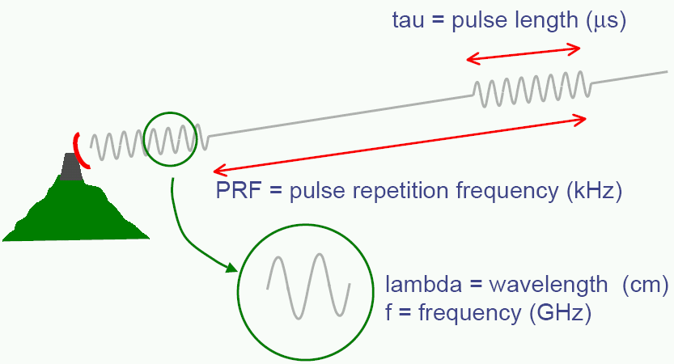
How it works

Slide 11
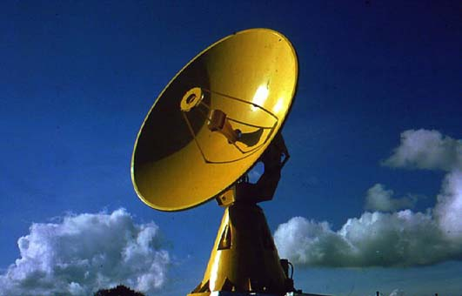
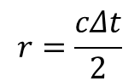
How it works
The scatterers are characterized with respect to the radar :
Radial distance :
Azimuth : β
Elevation : α
Received signal with respect to the distance of the scatterer
$$r=\frac{cΔt}{2}$$
Geographical location
scatterer
r
α
North
β
Physical properties

Slide 12
Resolution
Vertical resolution
1°
Range :
Vertical resolution :
50 km 100 km 150 km 200 km
0.9 km 1.8 km 2.6 km 3.5 km
Horizontal resolution in azimuth = vertical resolution
Horizontal resolution in distance: Depends on the speed of light and the pulse duration
$$Δr=\frac{cτ}{2}$$

Slide 13
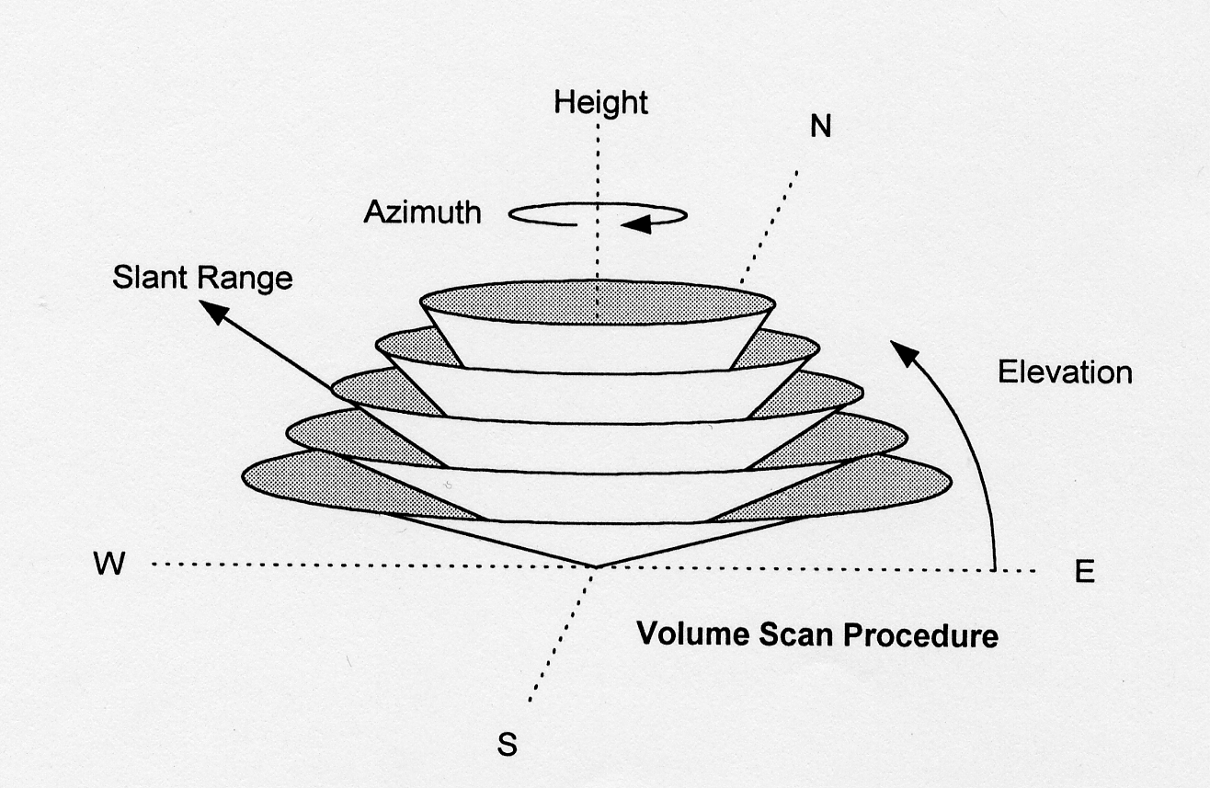
Scanning strategy
x elevations / x min
1 sweep/ x s

Slide 14
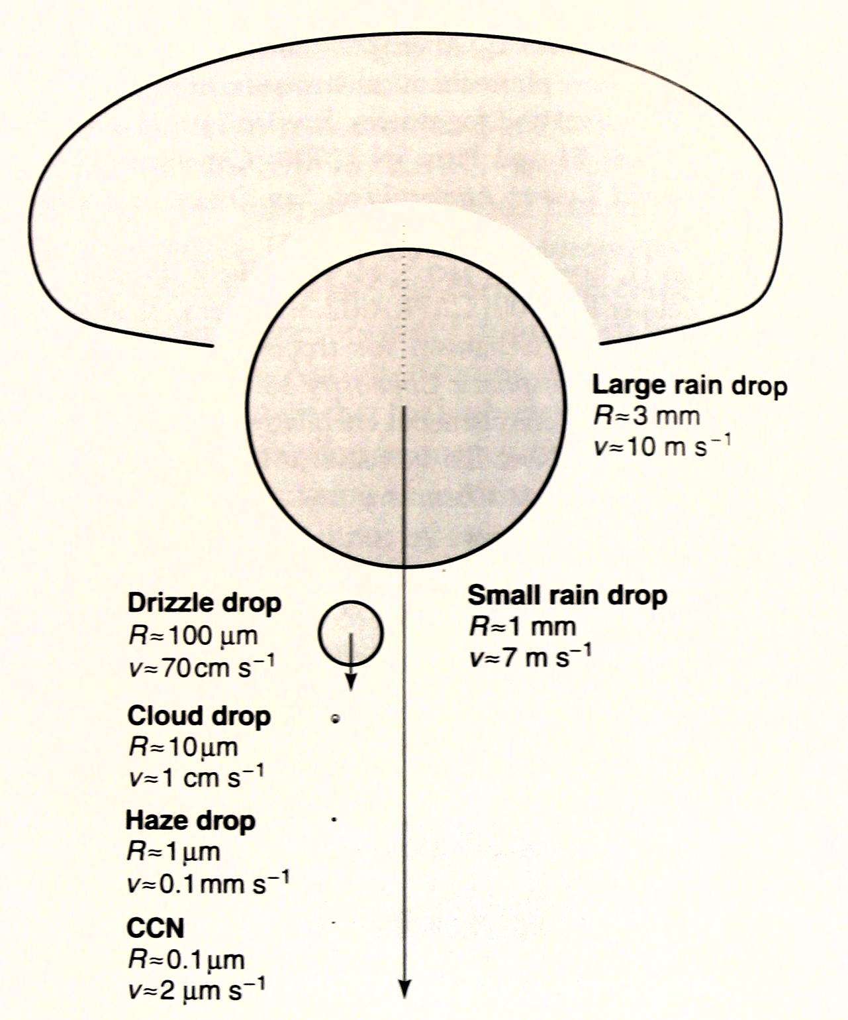
Radar wavelength
The choice of the radar wavelength is determined by the size of the scatterer that has to be observed.
The wavelength should be an order of magnitude larger than the scatterer
Larger wavelength require larger antennas to obtain the same beamwidth
Typical hydrometeor sizes :
Drizzle drop : 0.1 to 0.5 mm
Rain drop : 0.5 to 5 mm
Snowflake : 2 to 5 mm
Hailstone : 5 to 50 mm

Slide 15
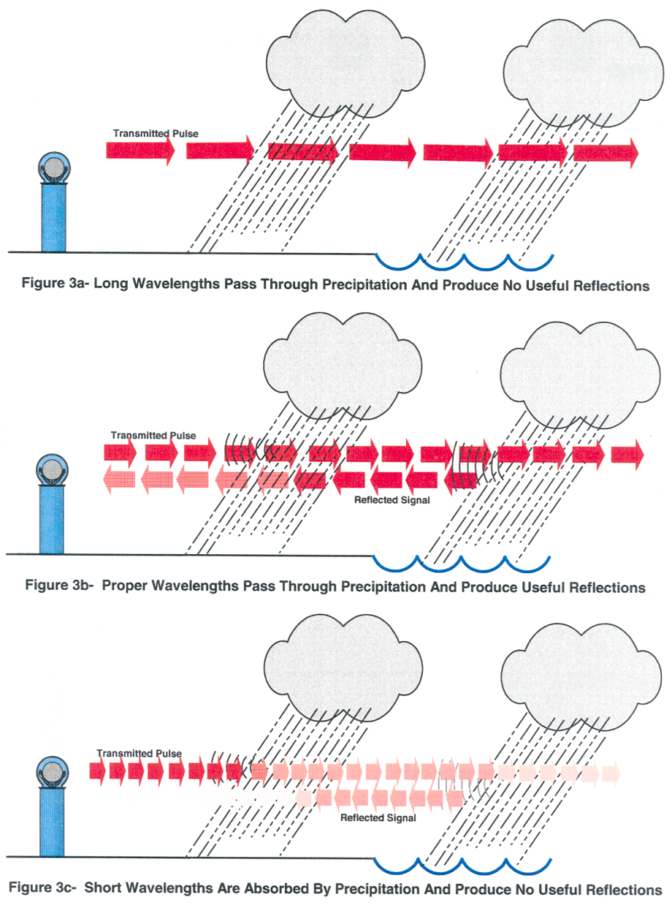
Radar wavelength

Slide 16
Radar wavelength
wavelength (cm) | 1 | 3 | 5 | 10 | 20
frequency (GHz) | 30 | 10 | 6 | 3 | 1,5
Band | K | X | C | S | L
usage | clouds | precipitation | precipitation | precipitation | aeronautical

Slide 17
3. The weather radar equation

Slide 18
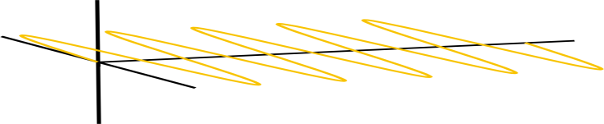

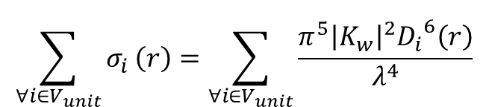
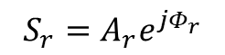
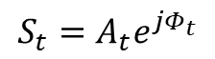
Radar equation for weather radar
Power density incident on target
Uniform beam filling
Gaussian antenna pattern
$$P_{r}\left(r\right)=\frac{P_{t}}{4πr^{2}}G_{t}\frac{1}{4πr^{2}}σ\left(r\right)\frac{G_{r}λ^{2}}{4π}$$
$$σ\left(r\right)=V\left(r\right)\sum_{∀i}{σ_{i}}\left(r\right)=πr^{2}\frac{θ^{2}}{4}\frac{cτ}{2}\frac{1}{2ln2}\sum_{∀i∈V_{unit}}{σ_{i}}\left(r\right)$$
$$\sum_{∀i∈V_{unit}}{σ_{i}}\left(r\right)=\sum_{∀i∈V_{unit}}{\frac{π^{5}{\left|K_{w}\right|}^{2}{D_{i}}^{6}\left(r\right)}{λ^{4}}}$$
Power density at Rx antenna
Rx antenna aperture
Rayleigh scattering
Spherical shape
$$S_{t}=A_{t}e^{jΦ_{t}}$$
Tx
P_{t}
θ
r
Rx
P_{r}
$$Δr=\frac{cτ}{2}$$
$$S_{r}=A_{r}e^{jΦ_{r}}$$

Slide 19
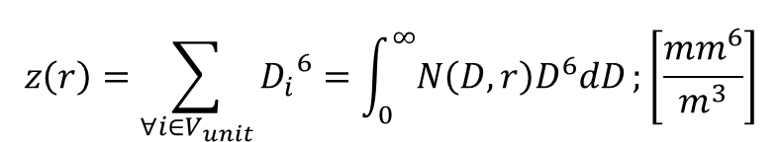
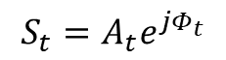
Radar equation for weather radar
$$P_{r}\left(r\right)=\frac{P_{t}}{4πr^{2}}G_{t}\frac{1}{4πr^{2}}σ\left(r\right)\frac{G_{r}λ^{2}}{4π}=\frac{π^{3}P_{t}G_{t}G_{r}θ^{2}τc}{1024ln2λ^{2}}\frac{1}{r^{2}}{\left|K_{w}\right|}^{2}z\left(r\right)=\frac{{\left|K_{w}\right|}^{2}}{{Cr}^{2}}z\left(r\right);\left[W\right]$$
$$z\left(r\right)=\sum_{∀i∈V_{unit}}{{D_{i}}^{6}}=\int_{0}^{∞}{N\left(D,r\right)D^{6}dD};\left[\frac{{mm}^{6}}{m^{3}}\right]$$
$$LWC\left(r\right)=\int_{0}^{∞}{N\left(D,r\right)V_{d}\left(D\right)dD};\left[\frac{{mm}^{3}}{m^{3}}\right]$$
$$R\left(r\right)=\int_{0}^{∞}{N\left(D,r\right)V_{d}\left(D\right)v_{t}\left(D\right)dD};\left[\frac{mm}{h}\right]$$
$$S_{t}=A_{t}e^{jΦ_{t}}$$
Tx
P_{t}
θ
r
Rx
P_{r}
$$Δr=\frac{cτ}{2}$$
$$S_{r}=A_{r}e^{jΦ_{r}}$$

Slide 20
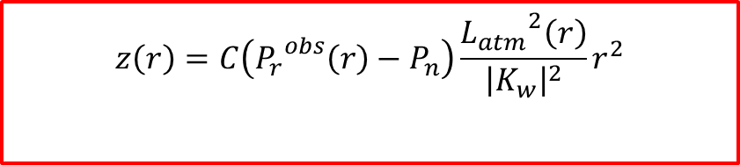
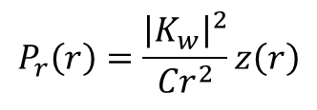
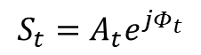
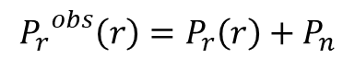
Radar equation for weather radar
$$P_{r}\left(r\right)=\frac{{\left|K_{w}\right|}^{2}}{{Cr}^{2}}z\left(r\right)$$
$${P_{r}}^{obs}\left(r\right)=P_{r}\left(r\right)+P_{n}$$
$$z\left(r\right)=C\left({P_{r}}^{obs}\left(r\right)−P_{n}\right)\frac{{L_{atm}}^{2}\left(r\right)}{{\left|K_{w}\right|}^{2}}r^{2}$$
$$S_{t}=A_{t}e^{jΦ_{t}}$$
Tx
P_{t}
θ
r
Rx
P_{r}
$$Δr=\frac{cτ}{2}$$
$$S_{r}=A_{r}e^{jΦ_{r}}$$

Slide 21
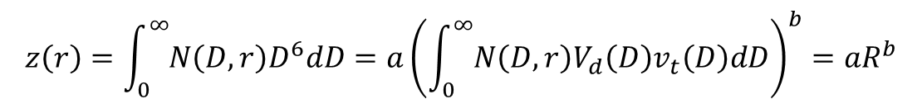
Relationship reflectivity - rainfall rate
$$z\left(r\right)=\int_{0}^{∞}{N\left(D,r\right)D^{6}dD}=a{\left(\int_{0}^{∞}{N\left(D,r\right)V_{d}\left(D\right)v_{t}\left(D\right)dD}\right)}^{b}={aR}^{b}$$
Depends on type of precip
Empirically derived
Parameters a and b depend on knowledge of Particle Size Distribution PSD N(D, r)
Most likely a and b can be derived statistically using long-term observations
However, individual precipitation events may deviate significantly from the average relationship
Use of auxiliary information to better characterize the PSD

Slide 22
4. Polarimetry

Slide 23
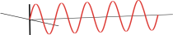
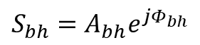
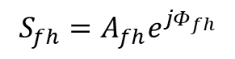
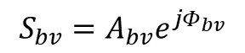
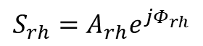
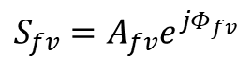
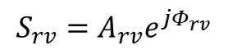
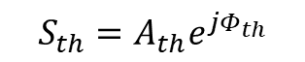
Polarimetry
$$S_{th}=A_{th}e^{jΦ_{th}}$$
Tx
P_{t}
θ
r
Rx
P_{r}
$$S_{rh}=A_{rh}e^{jΦ_{rh}}$$
$$S_{bh}=A_{bh}e^{jΦ_{bh}}$$
$$S_{fh}=A_{fh}e^{jΦ_{fh}}$$
$$S_{rv}=A_{rv}e^{jΦ_{rv}}$$
$$S_{bv}=A_{bv}e^{jΦ_{bv}}$$
$$S_{fv}=A_{fv}e^{jΦ_{fv}}$$

Slide 24
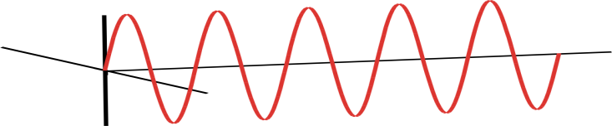
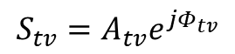
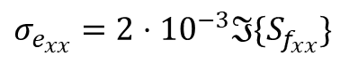
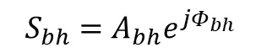
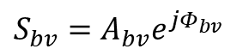
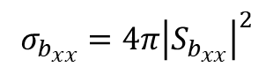
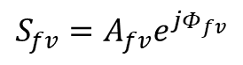
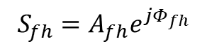
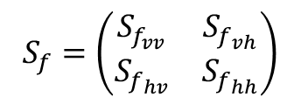
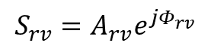
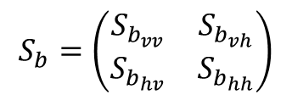
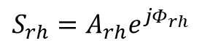
Polarimetry
$$S_{b}=\left(\begin{matrix}S_{b_{vv}} & S_{b_{vh}} \\ S_{b_{hv}} & S_{b_{hh}}\end{matrix}\right)$$
$$σ_{b_{xx}}=4π{\left|S_{b_{xx}}\right|}^{2}$$
$$S_{f}=\left(\begin{matrix}S_{f_{vv}} & S_{f_{vh}} \\ S_{f_{hv}} & S_{f_{hh}}\end{matrix}\right)$$
$$σ_{e_{xx}}=2⋅{10}^{−3}ℑ\{S_{f_{xx}}\}$$
$$S_{tv}=A_{tv}e^{jΦ_{tv}}$$
Tx
P_{t}
θ
r
Rx
P_{r}
$$S_{rv}=A_{rv}e^{jΦ_{rv}}$$
$$S_{bv}=A_{bv}e^{jΦ_{bv}}$$
$$S_{fv}=A_{fv}e^{jΦ_{fv}}$$
$$S_{rh}=A_{rh}e^{jΦ_{rh}}$$
$$S_{bh}=A_{bh}e^{jΦ_{bh}}$$
$$S_{fh}=A_{fh}e^{jΦ_{fh}}$$

Slide 25
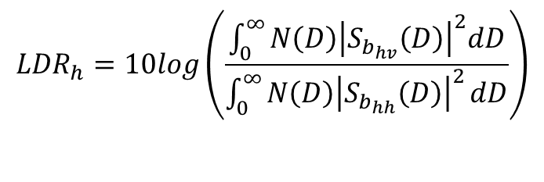





Polarimetric variables
$$z_{e_{xx}}=\frac{λ^{4}}{π^{5}}\frac{1}{{\left|K_{w}\right|}^{2}}{10}^{6}\int_{0}^{∞}{N\left(D\right)σ_{b_{xx}}\left(D\right)dD}$$
$$Z_{dr}=10log\left(\frac{z_{hh}}{z_{vv}}\right)$$
$${LDR}_{h}=10log\left(\frac{\int_{0}^{∞}{N\left(D\right){\left|S_{b_{hv}}\left(D\right)\right|}^{2}dD}}{\int_{0}^{∞}{{N\left(D\right)\left|S_{b_{hh}}\left(D\right)\right|}^{2}}dD}\right)$$
$$ρ_{hv}=\frac{4λ^{4}}{π^{4}}\frac{1}{{\left|K_{w}\right|}^{2}}{10}^{6}\frac{\left|\int_{0}^{∞}{N\left(D\right)S_{b_{hh}}\left(D\right)S_{b_{vv}}^{\text{∗}}\left(D\right)dD}\right|}{\sqrt{z_{hh}z_{vv}}}$$
$$A_{xx}=4.34⋅{10}^{3}\int_{0}^{∞}{N\left(D\right)σ_{e_{xx}}\left(D\right)dD}$$
$$δ_{co}=\frac{180}{π}arg\left[\int_{0}^{∞}{N\left(D\right)S_{b_{hh}}\left(D\right)S_{b_{vv}}^{\text{∗}}\left(D\right)dD}\right]$$
$$KDP=\frac{180}{π}λ\int_{0}^{∞}{N\left(D\right)ℜ\{S_{f_{hh}}\left(D\right)−S_{f_{vv}}\left(D\right)\}dD}$$
Backward scattering
Forward scattering

Slide 26









STAR polarimetric measurements
$$z_{ehh}\left(r\right)=C_{hh}\left(P_{r_{hh}}\left(r\right)−P_{n_{hh}}\right)\frac{{L_{{atm}_{hh}}}^{2}\left(r\right)}{{\left|K_{w}\right|}^{2}}r^{2}$$
$$Z_{dr}=10log\left(\frac{z_{hh}}{z_{vv}}\right)$$
$$z_{evv}\left(r\right)=C_{vv}\left(P_{r_{vv}}\left(r\right)−P_{n_{vv}}\right)\frac{{L_{{atm}_{vv}}}^{2}\left(r\right)}{{\left|K_{w}\right|}^{2}}r^{2}$$
$$K_{dp}\left(r\right)=\frac{1}{2}\frac{dΦ_{dp}\left(r\right)}{dr}=\frac{Φ_{dp}\left(r_{2}\right)−Φ_{dp}\left(r_{1}\right)}{2Δr}$$
$$Φ_{dp}\left(r\right)=Φ_{hh}\left(r\right)−Φ_{vv}\left(r\right)$$
$$ρ_{hv}\left(r\right)=\frac{\left\langle \left|S_{rh}{S_{rv}}^{\text{∗}}\right|\right\rangle }{P_{rh}P_{rv}}$$
$$S_{t}=A_{th}e^{jΦ_{th}}+A_{tv}e^{jΦ_{tv}}$$
Tx
P_{t}
θ
r
$$S_{rh}=A_{hh}e^{jΦ_{hh}}+A_{vh}e^{jΦ_{vh}}$$
Rx
P_{r}
$$S_{rv}=A_{vv}e^{jΦ_{vv}}+A_{hv}e^{jΦ_{hv}}$$

Slide 27




Polarimetric radar observations
$${z_{hh}}^{obs}\left(r\right)=z_{hh}\left(r\right)−2\int_{0}^{r}{a_{h}\left(r\right)dr}−2{a_{h}}^{radome}+ΔZ_{hh}+σ_{z_{hh}}$$
$${z_{dr}}^{obs}\left(r\right)=z_{dr}\left(r\right)−2\int_{0}^{r}{a_{dp}\left(r\right)dr}−2{a_{dp}}^{radome}+ΔZ_{dr}+σ_{z_{dr}}$$
$${Ψ_{dp}}^{obs}\left(r\right)=2\int_{0}^{r}{K_{dp}\left(r\right)dr}+δ_{co}\left(r\right)+Φ_{{dp}_{0}}+σ_{Φ_{dp}}$$
$${ρ_{hv}}^{obs}\left(r\right)=ρ_{hv}\left(r\right)+σ_{ρ_{hv}}$$

Slide 28


reflectivity

Slide 29



Differential reflectivity
Linked to hydrometeor shape
Raindrop size
Ø 4
Ø 3.68
Ø 2.9
D in mm.
Ø 2.65
Ø 1.75
Ø 1.35

Slide 30


Co-polar correlation coefficient
Linked to heterogeneity of the scatterers
Hydrometeor phase
Antenna quality

Slide 31


Differential phase
Linked to attenuation

Slide 32


Specific differential phase
Linked to liquid water content

Slide 33
5. Doppler moments

Slide 34

The Doppler effect
Discovered by Christian Doppler in 1842
$$V_{r}=\frac{λ}{4πPRT}ΔΦ$$

Slide 35



Nyquist velocity
$$V_{r}∈\left]−V_{Nyquist},+V_{Nyquist}\right];V_{Nyquist}=\frac{λ}{4PRT}$$
$$ΔΦ∈\left]−π,π\right]$$
Folded Vr
True Vr
Unambigous velocity range
$${V_{r}}^{true}={V_{r}}^{obs}+2{kV}_{Nyquist}$$

Slide 36



Doppler dilemma
$$V_{Nyquist}=\frac{λPRF}{4}$$
↑PRF => ↑ vNyquist BUT ↓ rrmax
$$r_{max}=\frac{c}{PRF}$$
Solution : MULTIPLE PRF
We get 2 or more Vr potentially folded in 2 or more ±Vnyquist
Combining them properly we can extend the Nyquist interval

Slide 37
Doppler spectrum
The received signal phase will be a combination of multiple single scatterer returns
Combining several pulses we can obtain the Doppler spectrum
The averaged velocity is the Doppler velocity representative of the global displacement (with respect to the radar) within the radar volume
We can compute higher order moments such as the Doppler spectrum width WD
WD is related to the turbulence within the radar volume
wD
V
VD
Ground clutter is centered around 0 m/s

Slide 38
6. Sources of uncertainty

Slide 39


Sources of uncertainty
Attenuation by precipitation
VPR correction
Attenuation by gases
Calibration of the radar system
Conversion of Z_{H} into R
(wet) radome attenuation
Artefacts
Ground-clutter identification
Partial beam blocking correction
Revisit time reduction using the advection field
Secondary lobe reception
Secondary trip echoes
Anomalous Propagation
...

Slide 40

Clutter identification

Slide 41
Calibration
Calibration: In measurement technology and Metrology is the comparison of measurement values delivered by a device under test with those of a calibration standard of known accuracy (reference). Such a standard could be another measurement device of known accuracy, a device generating the quantity to be measured, etc.
References: internal signal generator, metallic sphere, sun, light rain, precipitation when pointing at the vertical, ground clutter, etc.

Slide 42

Thank you! Grazie mille! Moltes Gràcies! Merci!

